Slide 1
Advanced Phishing Threats (APT) – Exploiting Modern Features
Payton Miller

Slide 2


Cyber Security Engineer at Open Security
Certifications: GSEC, GCIH, GPEN, (GEVA + GFACT)
SANS UACS Scholar
I absolutely love finding obscure ways to break applications, on modern web applications, or the legacy protocols that support them.
@aLilSus
Notes:
Hello everyone, my name is Payton Miller.
I’m a cyber security engineer with open security, since my under-graduation graduation at SANS.

Slide 3
What is Phishing?

Slide 4
Terms
Social Manipulation – Convincing a victim to perform an action that results in any information disclosure.
Phishing – Social Manipulation via Email
Vishing – Social Manipulation via Voice

Slide 5
Identifiers of Phishing
Bait – Issue or service that the individual needs to resolve.
Register for new company benefits.
Download an update to secure your system
You qualify for an Economic Impact Payment (EIP)
Deadlines – Call to Action that pressures individuals to interact with the email.
Failure to submit this data by Tuesday, will result in account termination.

Slide 6
Where we are?
Notes:
22mins

Slide 7

Domain Sprawl
Domain name per service.
Trusted domains / partners are not listed publicly.
Organizations recommend third-party services.
Indexing websites are information disclosures
/sitemap.xml and /robots.txt – provide search engines with too much information of files that should not be discoverable, similar implications of providing external service lists.

Slide 8
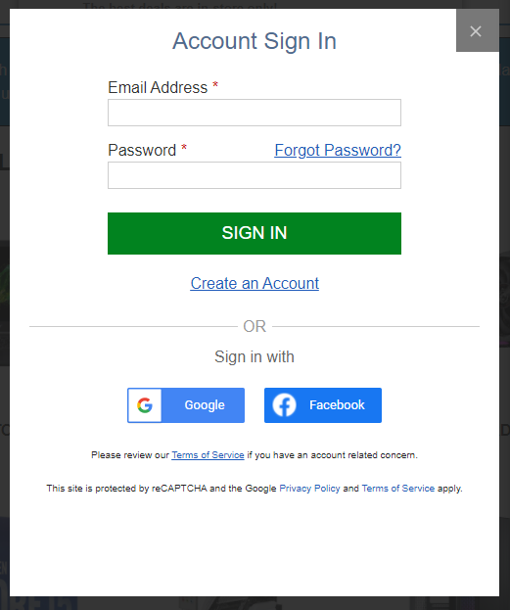
Third Party APIs
APIs – websites requesting data from other publicly trusted websites.
Authentication (Facebook, Google, Microsoft)
Payment Portals (Stripe, Square, Paypal)

Slide 9
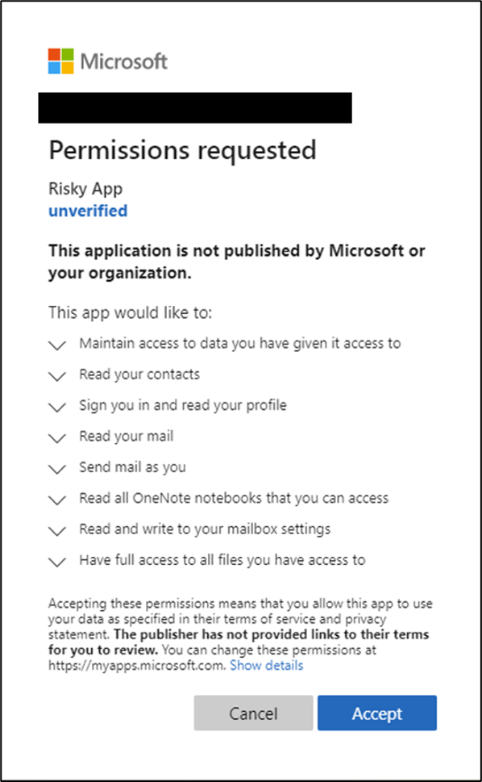
Consent Based Phishing
Clicking “Accept” allows this application to perform all actions
Permissions should be delegated on a principle of least privileged.
What could result from accepting this malicious application?
https://t.co/AvYxbfrjRN
Agnieszka Girling, A. G. (2020, July 8). Protecting your remote workforce from application-based attacks like consent phishing. Microsoft. https://www.microsoft.com/security/blog/2020/07/08/protecting-remote-workforce-application-attacks-consent-phishing/
Notes:
Agnieszka Girling, A. G. (2020, July 8). Protecting your remote workforce from application-based attacks like consent phishing. Microsoft. https://www.microsoft.com/security/blog/2020/07/08/protecting-remote-workforce-application-attacks-consent-phishing/
It’s important to note that while this API is incredibly verbose, some are incredibly vague as to what actions they perform.

Slide 10
Typo Domain Squatting
Purchasing a domain like Google.com
Remove characters
Duplicate characters
Choose different TLDs
Follow the organization’s naming convention of other popular services by that web entity.

Slide 11
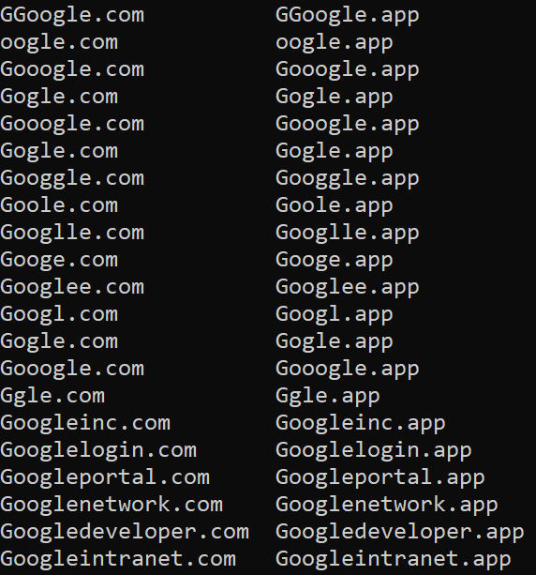
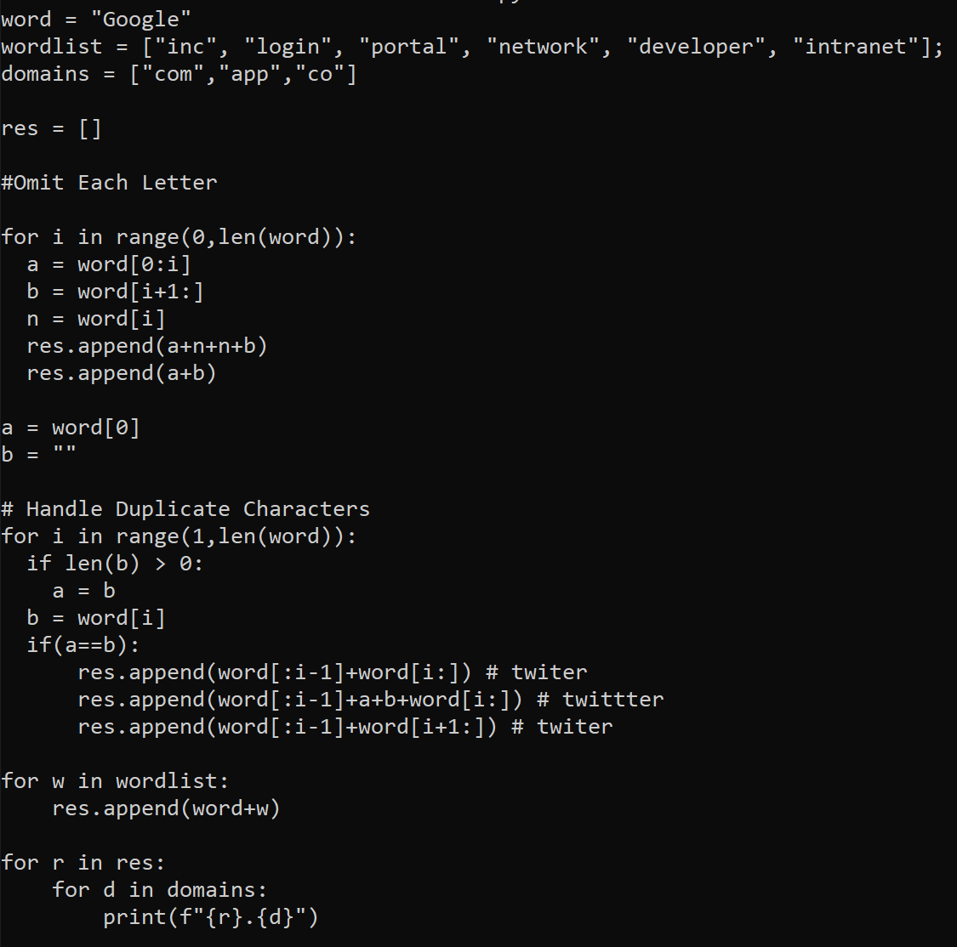
Python Subdomain Enumeration in BSsides-Resources

Slide 12
Internationalized Domain Names (IDNs)
Majority of browsers display Punycode variant.
Firefox by default displays symbolic domain name.
Limit using one character set.
Hard to obtain legitimacy. Easily detected as malicious.
Symbolic Domain Name | Punycode Equivalent
ᴍicrosoft.com | http://xn--icrosoft-qy7c.com/
тшіттег.com | http://xn--c1ad2baa8a0g.com/
Notes:
Punycode is a form of encoding, prefix with xn– which implements Unicode in

Slide 13
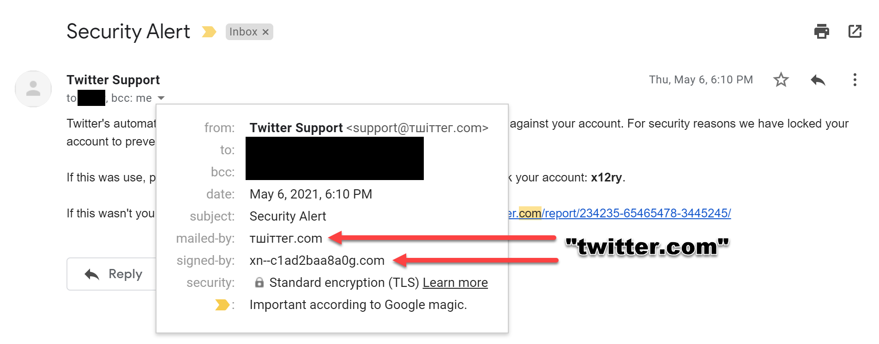

Slide 14
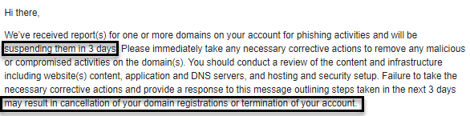
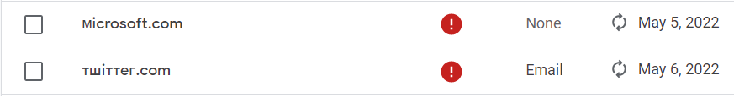

Slide 15
Achieving legitimacy through complexity.

Slide 16
General Techniques

Slide 17
Inheriting Trust
Site Exploitation – if users trust the organization, then we become the organization.
Open Redirections – Redirect to a website that we control to harvest information.
Cross Site Scripting (XSS)
http://test.com/redirect?url=http://attacker.co/

Slide 18
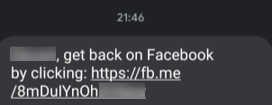
Abusable Services that perform actions for us
Link Shorteners
t.co, fb.me, bit.ly
File Hosting
Google Storage
S3 Buckets
Free Subdomains
https://[domain].web.app
https://[domain].firebase.com
https://[domain].appspot.com
https://[domain].azuresites.net

Slide 19
Trusted Services that perform actions for us
Trusted Platform as a Service
External adversary sends meeting invite to employee of an organization.
Internal employee sees the meeting, and rushes to get in the call.
Meeting invite contains a link to a third-party videoconferencing application, which contains a backdoor.
Employee in a rush to join the meeting, does not trust the software, but supervisors expect that employee to be in the meeting.

Slide 20
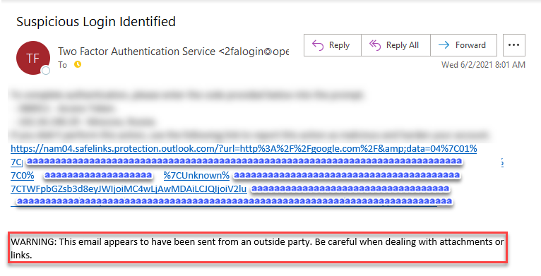
Link Filtering
Email services replaces external links to a managed open redirection.
If the redirection is flagged as malicious the organization can “stop” the redirection.

Slide 21
Subdomain Impersonation

Slide 22
Requirements of a Subdomain
Accepted Standard.
Allowed Characters: [A-z 0-9 -_ . ]
Subdomain Delineator: [.]
Wildcard: [*]
Subdomain Divisions
Less than 127 subdivisions
Each division shorter than 63 characters
Total subdomain length shorter than 253-255 characters.

Slide 23
Valid Subdomains
app.app.app.app.app.app.app.app.app.app.app.
app.app.app.app.app.app.app.app.app.app.app.
app.app.app.app.app.app.app.app.app.app.app.
app.app.app.app.app.app.app.app.app.app.app.
app.app.app.app.app.app.app.app.app.app.app.
app.app.app.app.app.app.z1l.cc
The domains: z1l.cc and z1l.co are currently for sale 20$/y and 30$/y.
I do not own or control the content on these domain names.

Slide 24
Valid Subdomains
aaaaaaaaaaaaaaaaaaaaaaaaaaaaaaaaaaaaaaa
aaaaaaaaaaaaaaaaaaaaa.aaaaaaaaaaaaaaaaaa
aaaaaaaaaaaaaaaaaaaaaaaaaaaaaaaaaaaaaaa
aaa.aaaaaaaaaaaaaaaaaaaaaaaaaaaaaaaaaaaa
aaaaaaaaaaaaaaaaaaaaaaaa.aaaaaaaaaaaaaaa
aaaaaaaaaaaaaaaaaaaaaaaaaaaaaaaaaaaaaaa
aaaaaa.z1l.cc
The domains: z1l.cc and z1l.co are currently for sale 20$/y and 30$/y.
I do not own or control the content on these domain names.

Slide 25
Valid Subdomains
http.steam.com.forum-23489324832432.
homepage.z1l.cc
The domains: z1l.cc and z1l.co are currently for sale 20$/y and 30$/y.
I do not own or control the content on these domain names.

Slide 26
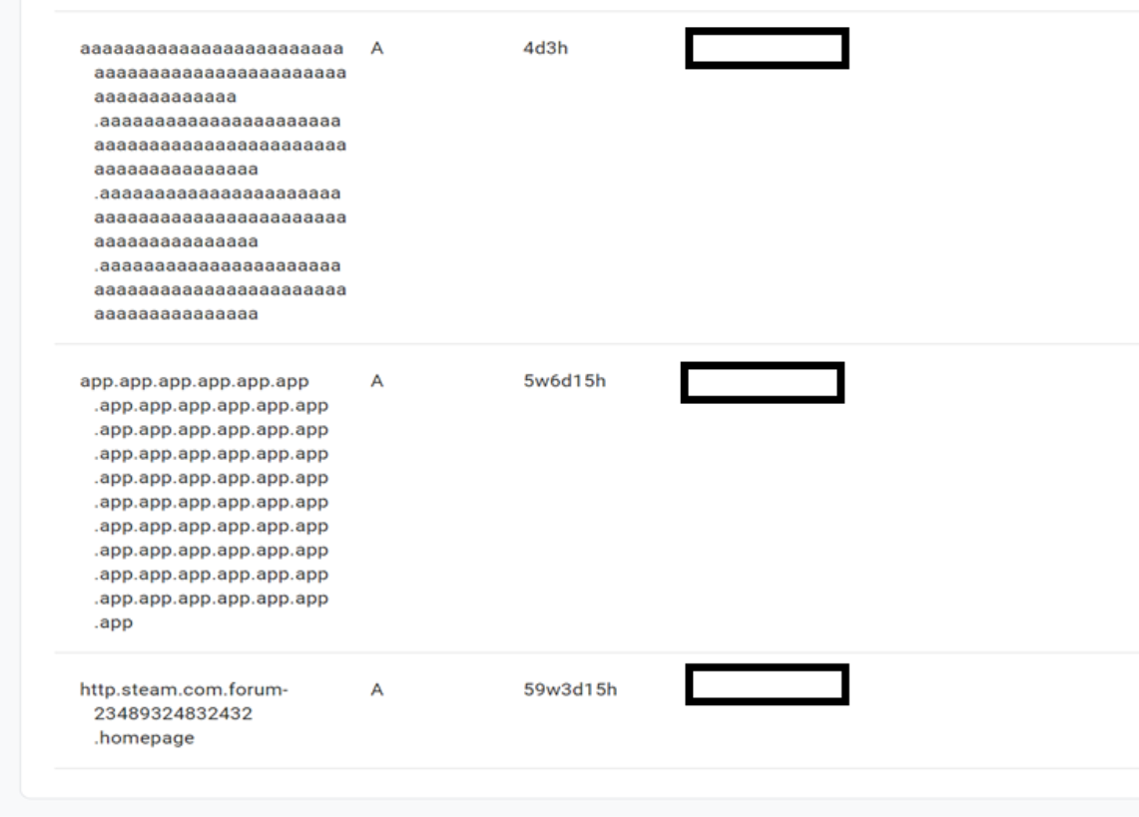
test.com
test.com
test.com

Slide 27
Impersonation via Subdomains
1) Find a trusted website with a long URL.
2) Open Subdomain Impersonator
3) Update DNS.

Slide 28
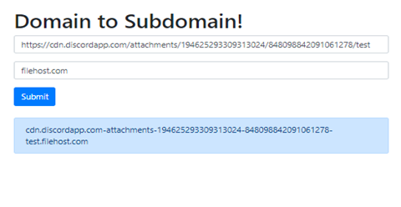
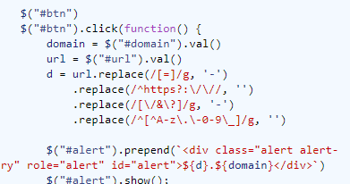
Impersonation via Subdomains
Replace = with -
Deleting http(s)://
Replace ?&/ with –
Delete bad characters
Append your domain name

Slide 29
Impersonation via Subdomains
https://cdn.discordapp.com- attachments-2343456456457345435-23434254364364564.test.download

Slide 30
Impersonation via Subdomains
https://cdn.discordapp.com- attachments-2343456456457345435-23434254364364564.test.download
Domain Name

Slide 31
Left-To-Right Override and Right-To-Left Override

Slide 32
LTRO and RTLO Encoding
Some languages including Arabic, Hebrew, Syriac, and Thaana (Divehi) are right to left.
Windows supports “bi-directional text encoding”… permits both directions in the same text-field
Is it a feature or vulnerability? What is the risk in bidirectional text encoding?

Slide 33
LTRO and RTLO Encoding
Displayed Filename | Assumed extension | Real Extension
2021.Executive Summary.docx | .docx | .exe
Advertising for Bsides.lnk.docx | .docx | .lnk
.Jschaeffer Account – Invoice.pdf | .pdf | .js
Amazon.com – Invoice.pdf | .pdf | .com (.exe)
RTLO (◄) is a symbol that overrides the text encoding from LTR to RTL with an Override
LTRO (►) is a symbol that overrides the text encoding from RTL to LTR with an Override
What happens when the content in the rendered field does not match the real content of a field?

Slide 34
Displayed Filename | Unicode Filename | File Extension
2021.Executive Summary.docx | 2021◄xcod.yrammuS evituc►.Exe | .exe
Advertising for Bsides.lnk.docx | Advertising for Bsides◄xcod.►.lnk | .lnk
.Jschaeffer Account – Invoice.pdf | ◄fdp.eciovnI – tnuoccA reffeahc►.Js | .js
Amazon.com – Invoice.pdf | Amazon◄fdp.eciovnI – ►.com | .com (.exe)
RTLO (◄) is a symbol that overrides the text encoding from LTR to RTL with an Override | LTRO (►) is a symbol that overrides the text encoding from RTL to LTR with an Override

Slide 35
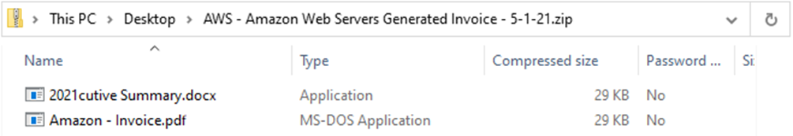
“File Name Extensions” - Disabled

Slide 36
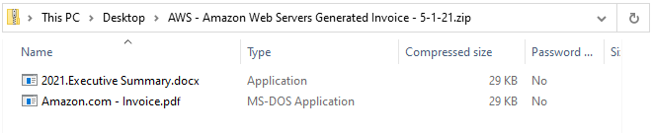
“File Name Extensions” - Enabled

Slide 37
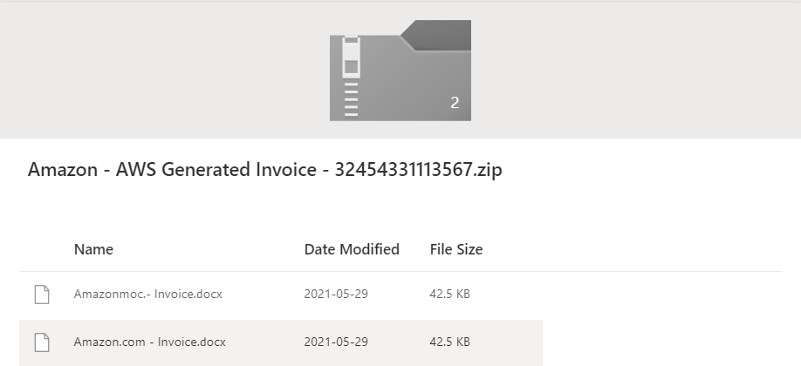
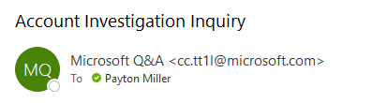

Slide 38
What can we do?

Slide 39
How to Protect Individuals
Password Managers – URL matching to prevent disclosing your credentials to domains that are illegitimate.
2FA – Individuals think twice before entering 2FA tokens and ensure that they are on valid websites.
Certain “Safe-Site” Scanners detect new domains – flagging them as malicious

Slide 40
How to Protect Individuals
Custom Chrome Themes – Prevents Windows Spoofing
If clicking a link is avoidable, consider directly navigating to the website.
Regular internal training to ensure that your organization can identify a large range of threats.

Slide 41
How to Protect your Organization
Implement valid DNS SPF / DMARC / DKIM on mail servers to prevent mail spoofing.
Reduce unnecessary domain redirections.
Consider exposing a list of domain names owned by the organization on the company’s TLD, or an exposed API to check valid endpoints.
Maintain web servers with regular vulnerability assessments, and services are secure.

Slide 42
ADDITIONAL RESOURCES
GitHub:
GitHub - trustedsec/social-engineer-toolkit
GitHub - kgretzky/evilginx2
GitHub - gophish/gophish
Resources:
Cross-site Scripting via WHOIS and DNS records on multiple lookup platforms - Research Advisory | Tenable®
Spoof Using Right to Left Override (RTLO) Technique - Infosec Resources (infosecinstitute.com)
Presentation Resources Github:
naivros/BSides-Phishing

Slide 43

Questions & answers
If you have any questions that have not been answered at this point, feel free to reach out to me directly on Twitter, or within #OpenSecurity, afterwards.
All scripts mentioned within this presentation are available at https://github.com/naivros/BSides-Phishing/
@aLilSus
@a.lil.sus#7939

